Slide 1
Machine Learning
Chatbot Presentation
Fall 2020
Team Member: Lan Haoning Liu Shenheng Chen Ke

Slide 2
Goals
Implement A Chatbot Using Deep Learning
achieve high performance
learn to implement popular neural language models such as Transformer, etc.
A presentation to sell your product/idea.
[optional] new ideas for open-domain dialogue generation

Slide 3
Presentation
A recorded (录好音的) pptx with the following contents:
Without Idea | With New Ideas
Background
Related Works
 | Motivation
Technology | Approach
Implementation Details
Evaluation
Demo
task allocation

Slide 4

Presentation: Background
Chatbot everywhere:
Conversation modeling in the industry:
search model, generate model
Information you have received about chatbot.
Your understanding about chatbot:
logic and smart

Slide 5
Presentation: Related Works
Paper:
Attention is all you need

Slide 6
Presentation: Motivation [optional]
If you have an new idea, please show
what is the main problem of existing approaches?
how do you address the problem?
what is the key idea of your model?

Slide 7
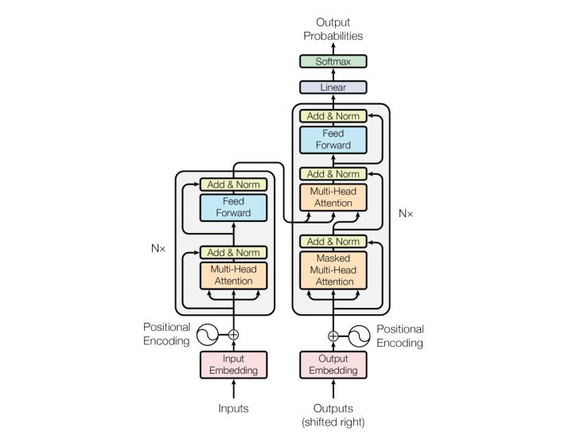
Presentation: Approach
Describe your approach using diagrams and descriptions (like how we introduced the Seq2Seq, Attention, Transformer, etc in the class).
For example:

Slide 8
Presentation: Implementation Details
More details of key components and algorithms (e.g., encoder, decoder, etc) in your implementation.

Slide 9
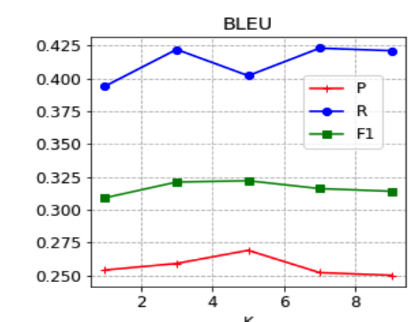
Presentation: Evaluation
Show the following results.
curves of loss and bleu scores in the validation set
comparison of different models (BLEUs) including the provided baseline in the test set.
brief descriptions about the results and comparisons.

Slide 10
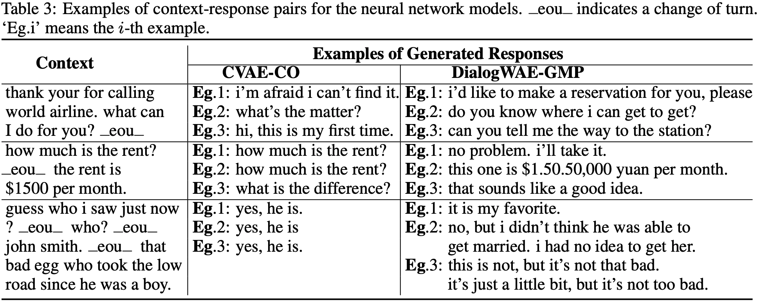
Presentation: Demo
Show some concrete examples (selected context and the generated response) yielded by both yours and the baseline model.
Example

Slide 11
Presentation: Task Allocation
> baseline | 95% baseline | 90% baseline | non-sense results
10pt | 8pt | 6pt | 0pt
Member | Contribution
Lan Haoning
Liu Shenheng
Chen KE

Slide 12
Grading Scheme
• Performance [10pt]
• Technical soundness [12pt]
Easy (e.g., no evident improvement, ): 5pt
Medium (e.g., little improvement): 9pt
Advanced ( e.g Transformer): 12pt
• Presentation [8pt]
-
[optional & bonus] new ideas [+10pt]
idea adopted +5pt,
and have shown that it works +5pt
> baseline | 95% baseline | 90% baseline | non-sense results
10pt | 8pt | 6pt | 0pt

Slide 13
Submission
group project (1-3 members)
one of the group member submit a single file named
‘ID1_NAME1_ID2_NAME2_ID3_NAME3.zip’ to Canvas
including:
- code: (proj2.ipynb)
- trained model (checkpoint_itr0.pkl)
- presentation (presentation.pptx with voice)
Due date: Jan. 3rd

